Slide 1

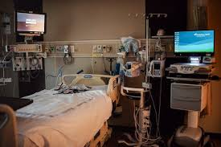
Presentation on Hospital ICU Room Hospital Name: xyz
Presented By: Gangadhar Tiwari
Last Update: 07-02-2025

Slide 2
AGENDA
Introduction
Objective
Data Gathering
Insight
Conclusion

Slide 3
OBJECTIVE
We need to create a Hospital ICU Room Analysis Dashboard to improve efficiency and provide useful insights. This dashboard will help stakeholders monitor, analyze, and make better decisions for managing patients and improving services.
So in this we are majorly focus on below points:
Patient Admit Status:
Show how many patients were admitted vs. not admitted.
Patient Age Distribution:
Group patients by age.
Timeliness:
Measure the percentage of patients seen within 30 minutes.
Gender Analysis:
Display the number of patients by gender.
Department Referrals:
Check which departments patients are referred to the most.

Slide 4
Data Gathering
The data has been acquired from online source in excel format.
After that I cleaned the data in excel power query, check the format and remove null values from it and also check the data type is it in correct form or not.
Then I load the data in excel and started creating visualization.
Raw Data Link:

Slide 5
Insights: Patient Admit Status
Sub Saharan has the highest profit.
North America has the lowest profit among all the regions.
Admit Status | No. of Patients | % Status
Admitted | 4131 | 49.99%
Not Admitted | 4132 | 50.01%

Slide 6
Insights: Patient Age Distribution.
In this we can see that
So in future we will be majorly focusing

Slide 7
Insights: Timeliness.

Slide 8
Insights: Gender Analysis.

Slide 9
Insights: Department Referrals

Slide 10
Conclusion
1. Improve ICU Admission Process
Analyze patient admit status trends to optimize bed allocation.
Develop strategies to minimize non-admission cases due to capacity constraints.
2. Optimize Patient Care by Age Group
Customize treatment protocols based on age distribution trends.
Ensure specialized care for high-risk age groups, such as elderly patients.
3. Ensure Gender-Sensitive Healthcare
Identify and address gender-based trends in ICU admissions.
Customize medical interventions based on gender-specific health needs.
4. Enhance Emergency Response Efficiency
Monitor timeliness data to improve patient wait times.
Implement streamlined triage systems to ensure more patients are seen within 30 minutes.

Slide 11
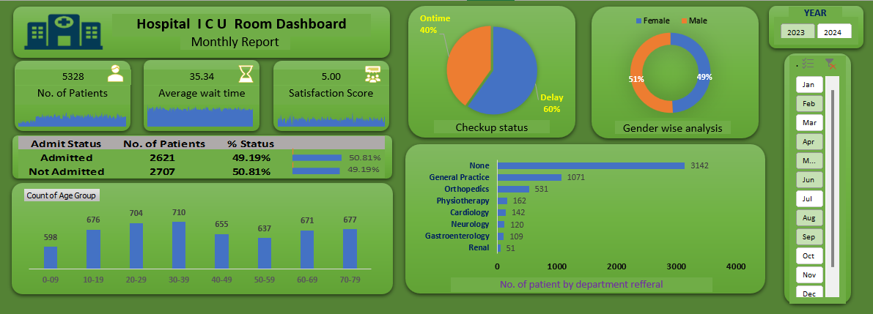
Final Dashboard

